Slide 1
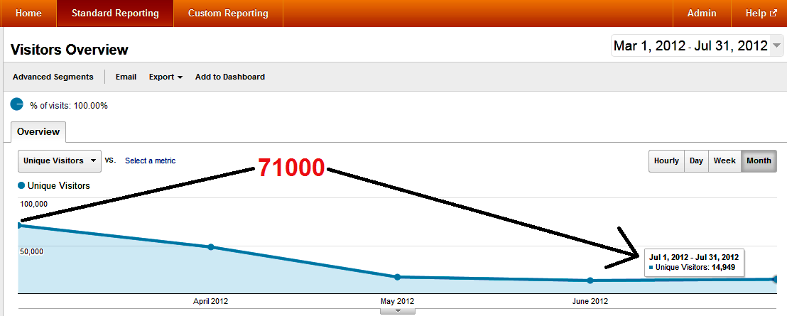
Effected Site : http://www.hospitality-school.com
Traffic Drop by Penguin Update

Slide 2
Example of Bad Search Result
Before penguin update these results were relevant. But now all bogus sites come first. Have a look
Hotel Room Service Procedure
Housekeeping Control Desk (Back link pages come first)
hotel night auditor
hotel linen room
par stock linen uniform hotel (Back link pages come first) etc

Slide 3
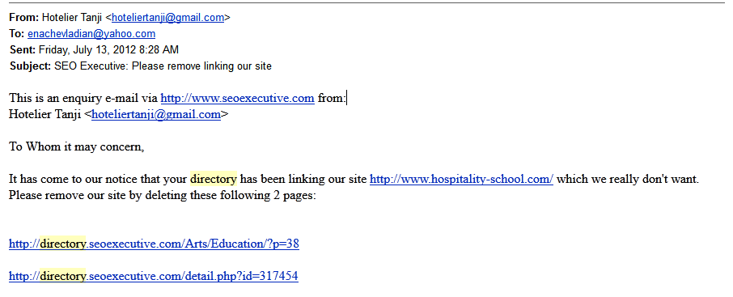
Bad Backlinks to our site
After seeing massive drop of traffic we have find some of sites mostly automatic content creation sites have linked us. We tried one by one to get those links removed but some demand extra payment and rest never response at all. Example:

Slide 4
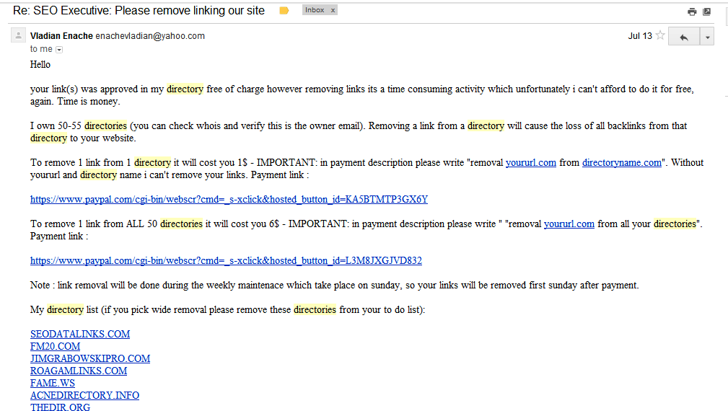
We got Such Reply:

Slide 5
List of those mentioned directories of the owner of SEOEXECUTIVE.COM are:
FIXDIRECTORY.INFO ANADIRECTORY.INFO ALPHACONTENT.INFO ALMADIRECTORY.INFO MYLINKSDIRECTORY.INFO ATVDIRECTORY.INFO ARENADIRECTORY.INFO APPLEDIRECTORY.INFO AAADIRECTORY.INFO forexdirectory1.info AZLINKDIRECTORY.INFO BINDIRECTORY.INFO A51DIRECTORY .INFO AIGLINK.INFO bbdirectory.info BETADIRECTORY.COM businesslinkz.info
DIRECTORY.SEOEXECUTIVE.COM
SEODATALINKS.COM FM20.COM JIMGRABOWSKIPRO.COM ROAGAMLINKS.COM FAME.WS ACNEDIRECTORY.INFO THEDIR.ORG ALLWEBDIRECTORY.INFO seolinkdir.info AXALINK.INFO AHDIRECTORY.INFO AWEBINDEX.INFO AZINDEX.INFO 888LINKS.INFO 911CATALOG.INFO 101WEBLINKS.INFO
AMYDIRECTORY.INFO 3WEBDIRECTORY.INFO AVATARDIRECTORY.INFO B52LINK.INFO C3DIRECTORY.INFO DAWNLINK.INFO EUROPELINK.INFO
ALIVELINK.INFO ALLDIRECTORY.INFO 1ASKDIRECTORY.INFO AWEBCATALOG.INFO ALIVECATALOG.INFO ALINKCATALOG.INFO AMAZINGCATALOG.INFO AIGINDEX.INFO AINDEX.INFO ALINKINDEX.INFO
ALLINDEX.INFO
Google should take immediate action against these sites from where the owner claim money to remove links

Slide 6
List of Backlinks We Really don’t want to get & can’t afford to remove because of silence from webmasters
From webmaster tool we have find these sites backlinked to us. We tried to email them or request to remove links from contact page but didn’t get any response:
http://www.japanese-music-song-singer.com/j-pop-video-wiki/yahoo-gazokensaku-50.php?key=orde
http://www.japanese-music-song-singer.com/j-pop-video-wiki/yahoo-gazokensaku-50.php?key=servi
http://cautare.poze.org/search/images?search=terminology&type=images http://www.geniusbot.com/index.php?page=search/images&search=check-out&type=images
http://www.inout-search-ultimate.com/search/images?search=hospitality%20industry&type=images
http://www.mywebfind.com/images/Front%20Office
http://www.mywebfind.com/images/Front%20Office
http://www.mywebfind.com/images/Service
http://www.szenesuche.de/search/images?search=service&type=images&startpage=3
http://www.yoconsearch.co.uk/search/images&search=service&type=images
http://www.yoconsearch.co.uk/search/images?search=restaurant&type=images&startpage=8
http://cautare.poze.org/search/images?search=terminology&type=images
http://pdfmeta.com/ma/service%20moneygram-pdf-1.html
http://prochef360blog.com/good-leader-kitchen/ http://suhd.com/lock-down-exe-file/

Slide 7
Continued
http://careeroffers.info/hotel-jobs/
http://mypcmentor.com/online-computer-training/online-training-it/
http://mypcmentor.com/online-computer-training/online-training-school/
http://mypcmentor.com/online-computer-training/online-training/
http://mypcmentor.com/online-computer-training/online-training-from/
http://celebspotlight.org/gallery/Check%20Out
http://careeroffers.info/hotel-jobs/
http://arkpropertyservices.com/bl-free-printable-reservations-forms.htm
http://dannycox.co.uk/506-printable-ebay-gift-card.html
http://arkpropertyservices.com/bl-fake-printable-divorce-license-template.htm
http://www.softviewer.com/comments.php?id=326793&mode=soft
http://mypcmentor.com/online-computer-training/a-online-training/
http://analyticsdigger.org/hospitality-school.com
http://talencentrum.bestelinks.nl/rubrieken/manager-ondernemer-horeca.html
http://www.szenesuche.de/search/images?search=service&type=images&startpage=3
http://www.ranknoodle.com/article/free-food-safety-training
http://search.refertus.info/Housekeeping http://www.searchcanvas.com/images?q=Order
http://piktura.mx/izw/uo-reborn-birth-certificate-%20printable.htm
http://russmillsart.com/uo-printable-birth-certificate-australia-counterfeit.htm
http://piktura.mx/izw/uo-printable-bird-birth-certificates.htm

Slide 8
Continued
http://hotelmanagment.hotelmanagementsystem.com/_7079_en-US__APP_HOTEL-MANAGEMENT-H_/Q_HOTEL+MANAGEMENT+COURSES+ONLINE/V_1/saas.aspx
http://members.affiliatebot.com/affiliates/bangladesh/2.html
http://www.agrieducation.org/XOORO/arts_humanities/artists/computers_and_internet/arts_humanities/education/?p=14
http://www.placeyourlinks.com/arts_humanities/education/?s=P&p=401
http://www.urltrends.com/viewtrend.php?url=hospitality-school.com&clearcache=yes
http://www.webhomemaker.com/blogs/business/page-22.html
http://softwarelist.us/-763410-Lock%20Down%20Exe%20File%201.0.html
http://www.softwarevault.com/Desktop-Applications/Lockdownexefile.xml
http://www.qdyu.com/showpads.php?sort=Date&cat=System%20Utilities&page=704
http://www.tsm-soft.com/Lock_Down_Exe_File_download_27905.html
http://wildcard.service.com/pages/t/types.service.htm
http://www.download4you.com/php/action.php?action=download&url=1&id=038164
http://www.download4you.com/php/action.php?action=download&url=2&id=038164
http://www.download4you.com/php/action.php?action=download&url=1&id=038164
http://www.download4you.com/php/action.php?action=download&url=2&id=038164
http://onske-gartneren.dk/nqzabc/cache/92f779ff3f654af95d7fff6cadc1eddb
http://hotelmanagment.hotelasp.com/_7079_en-US__APP_HOTEL-MANAGEMENT-H_/Q_HOTEL+MANAGEMENT+COURSES+ONLINE/V_1/saas.aspx

Slide 9
Continued
http://www.i5c.de/benutzer/3879/lesezeichen/4/
http://akademik.stptrisakti.ac.id/forums/showthread.php?pid=331
http://akademik.stptrisakti.ac.id/forums/showthread.php?pid=331&mode=linear
http://sharewareisland.com/application.aspx?FileId=1413718
http://www.bettermanagers.com/hotel_top10
http://www.freewaretown.com/application.aspx?FileID=1413718
http://www.sharewareisland.com/application.aspx?FileId=1413718
http://www.softviewer.com/comments.php?id=326793&mode=soft
http://www.softwarevault.com/Desktop-Applications/Lockdownexefile.xml
http://www.freeay.com/online-hospitality-degree-preparing-students-for-a-career-in-hospitality
http://ehotelier.com/discussion/topic/87293-career-tips-for-hotel-management-students/page__pid__172015 http://elibrary.bsi.ac.id/haltutor-2.html
http://elementtungstenl.uniquetemplates.net/feed/atom
http://www.softsidedpetcarrier.net/tag/delta/page/2/
http://elementtungstenl.uniquetemplates.net/feed/atom
http://hawaiian-table-linensa.hellotalktome.com/Hotel-Front-Office-Procedure
http://hawaiian-table-linensa.hellotalktome.com/feed/atom
http://www.plsearch.com/ASHOK%20K%20AGRAWAL
http://gmagoldie.hubpages.com/hub/Hotel-Terms
http://www.i5c.de/benutzer/3879/lesezeichen/6/
http://www.stpsahid.net/index.php?option=com_content&view=article&id=47&Itemid=53
http://www.stpsahid.net/index.php?option=com_content&view=article&id=62&Itemid=76
http://www.acronymgeek.com/DNS/Do_Not_Sell

Slide 10
Continued
http://www.renren.info/cyrilene?page=3
http://www.rujai.com/hi5/hotel-management
http://www.tsm-soft.com/Lock_Down_Exe_File_download_27905.html
http://www.ifsqn.com/forum/index.php/topic/15280-hotel-quality-system-procedures-forms-and-instructions
http://www.ifsqn.com/forum/index.php/topic/15280-hotel-quality-system-procedures-forms-and-instructions/page__pid__39965
http://www.ifsqn.com/forum/index.php/topic/15280-hotel-quality-system-procedures-forms-and-instructions/page__pid__40874
http://www.siamanswer.com/%E0%B8%A3%E0%B8%B9%E0%B8%9B%E0%B8%A0%E0%B8%B2%E0%B8%9E/Order
http://www.siamanswer.com/%E0%B8%A3%E0%B8%B9%E0%B8%9B%E0%B8%A0%E0%B8%B2%E0%B8%9E/Order
http://ezfreereport.com/yaz-court-case/
http://artificialintelligenceseo.com/external.php?http://www.hospitality-school.com
http://bookmarkurl.info/index.php?page=4&category=PCgames
http://directory.seoexecutive.com/detail.php?id=317454
http://domping.com/hospitality-school.com
http://glosslip.com/blogs/www.hospitality-school.com
http://just-download.com/security-privacy/lockdown/lock-down-exe-file-1.0.zip/36c7d
http://links.pingerati.net/people/hoteliertanji
http://washingtonindependent.com/79892/over-200000-march-for-immigration-reform/comment-page-2
http://washingtonindependent.com/79892/over-200000-march-for-immigration-reform?wpmp_switcher=mobile

Slide 11
Continued
http://www.consciousevolution.tv/tag/his-past/feed
http://www.consciousevolution.tv/tag/present-and
http://www.freeay.com/online-hospitality-degree-preparing-students-for-a-career-in-hospitality http://www.genex-solutions.com/training_videos
http://gopher.co/type_of_lodging_while.html
http://www.ontariorealtylicense.ca/latest-property-management-training-news-hotels-near-kia-georgia-new-hospitality-management-program
http://wrdsmith.com/words/lookup/cocktail
http://www.wrdsmith.com/words/lookup/flier http://www.inozemstvo-posao.com/smf_1-1-2_install/index.php?topic=4242.0;prev_next=prev
http://www.inozemstvo-posao.com/smf_1-1-2_install/index.php?topic=4255.msg41645
http://sharewareisland.com/application.aspx?FileId=1413718
http://www.freewaretown.com/application.aspx?FileID=1413718
http://www.sharewareisland.com/application.aspx?FileId=1413718
http://wrdsmith.com/words/lookup/compliment
http://wrdsmith.com/words/lookup/complimentary
http://wrdsmith.com/words/lookup/compliments

Slide 12
Continued
http://www.searchcanvas.com/images?q=Order
http://events.pingerati.net/tag/waiter
http://glosslip.com/blogs/www.hospitality-school.com
http://listings.pingerati.net/tag/waiter http://reviews.pingerati.net/tag/waiter
http://www.geniusbot.com/index.php?page=search/images&search=check-out&type=images
http://www.geniusbot.com/index.php?page=search/images&search=check-out&type=images http://www.inout-search-ultimate.com/search/images?search=hospitality%20industry&type=images
http://www.yoconsearch.co.uk/search/images&search=service&type=images
http://www.yoconsearch.co.uk/search/images?search=restaurant&type=images&startpage=8 http://elibrary.bsi.ac.id/haltutor-2.html
http://www.softoxi.com/download-lock-down-exe-file.html
http://www.bluesoftcenter.com/Lock_Down_Exe_File-211969.html
http://www.bluesoftcenter.com/freesharewarecenterdownld-211969.html
http://www.freesharewarecenter.com/Lock_Down_Exe_File-211969.html
http://www.plsearch.com/ASHOK%20K%20AGRAWAL
http://www.download4you.com/php/action.php?action=detail&id=038164
http://isladelagomera.net/crxgtd/bxst.php?bzkm=free-video-hygiene-food
http://www.sitedossier.com/site/www.hospitality-school.com

Slide 13
DMCA Cases Win-1
We found that many websites had copied our articles. We have win DMCA cases against following sites:
http://hotel-knowledge.blogspot.com (Multiple Pages)
http://www.balihospitality.net/ (Multiple Pages)
https://sites.google.com/site/vietnamhoteliers (Multiple Pages)
http://hotel-knowledge.blogspot.com (Multiple Pages)
http://hrdbali.blogspot.com/ (Multiple Pages)
http://dey-residivis.blogspot.com (Multiple Pages)
http://etople.com/ (Multiple Pages)
http://www.scribd.com (Multiple Pages)
http://epathsala.wordpress.com
http://onestophousekeeping.com/Handling_Guest_Complaint.html
http://rudolaip.blogspot.com/2011/01/kalimat.html
http://shirleytay89.blogspot.com/2010/02/proper-uniform-of-waiter.html
http://www.articlefeeder.com/Health_and_Fitness/Do_You_Suffer_From_Excessive_Sweating_.html
http://www.chef-wissamnajem.com/fbknowledge.htm

Slide 14
DMCA Cases Win-2
http://smagonyaasin.blogspot.com/2010/12/conversation-between-receptionist-and.html
http://ameerulnazreen.blogspot.com/2010/10/h-o-t-e-l-m-n-g-e-m-e-n-t.html
http://www.hotelone.com.pk/website2/JD/Front%20Office%20Basics.docx
http://sampiraiders.blogspot.com/2011/07/answering-telephone-in-hotel-restaurant.html
http://www.authorstream.com/Presentation/nuwaned-1371227-kitchen-tips/
http://www.authorstream.com/Presentation/nuwaned-1381988-7-never-ask-questions/
http://www.nihmt.org/atithyajan2012.pdf
http://www.red-grey.co.uk/general/waiter-uniform.html
http://www.scribd.com/doc/88489891/Actividad-3
http://wiwikyulihaningsih.wordpress.com/2011/01/11/how-to-be-a-successful-hotelier/
http://www.cookeryindia.com/students/Gu%E9ridon_Service.html
http://yudikartawijaya.wordpress.com/2011/05/27/groomimg-and-hygiene-guideline-for-server/
http://wenku.baidu.com/view/d60566ded15abe23482f4d8e.html

Slide 15
DMCA Cases Win-3
http://wiwikyulihaningsih.wordpress.com/2011/01/11/how-to-be-a-successful-hotelier/
http://www.hotelmanagementtutorial.com/inventory-of-hotel-room
http://www.hozpitalityplus.com/forum/topics/must-follow-golden-rules-for-hoteliers?xg_source=activity
https://georgekarapetyanworks.wordpress.com/2011/01/31/11-must-follow-golden-rules-for-hoteliers/
http://www.docstoc.com/docs/118891700/Front-Office-Basics
http://premprakashmixology.blogspot.com/
We spent hours after hours to find out such coping works. We hope Google will acknowledge our effort to make a spam free web world.

Slide 16
Our Mistakes-1
Unintentionally from our another site accounting-tutorial.com we have linked one of our page which was a tutorial about how to subscribe through feedburner email. When we saw that since that was placed in widget and so many backlinks created for that mistake we have removed that page from both site. But still google webmaster tools shows backlinks from that site.

Slide 17
Our Mistakes-2
The site is run by only 2 people Me & my wife. Because of our lack of knowledge by mistake in these pages there were multiple multiple <h1> tags which we came to know from bing webmaster tool. It was not intentional. And we removed those tags few weeks ago:
http://www.hospitality-school.com/hotel-room-inventory-housekeeping
http://www.hospitality-school.com/housekeeping-control-desk
http://www.hospitality-school.com/hotel-reservation-cancellation-code
http://www.hospitality-school.com/valet-laundry-service-hotel
http://www.hospitality-school.com/extended-stay-hotels
http://www.hospitality-school.com/job-sector-hospitality-student-hotelier
http://www.hospitality-school.com/culinary-arts-degree-careers
http://www.hospitality-school.com/foreign-currency-exchange-procedure-hotel
http://www.hospitality-school.com/hotel-cleaning-equipments-housekeeping-1
http://www.hospitality-school.com/how-hospitality-students-get-jobs-hotel
http://www.hospitality-school.com/career-hotel-industry
http://www.hospitality-school.com/how-get-online-hospitality-degree
http://www.hospitality-school.com/hotel-guest-room-amenities
http://www.hospitality-school.com/condo-hotel
http://www.hospitality-school.com/tourism-hospitality-industry-1
http://www.hospitality-school.com/hotel-cleaning-equipments-housekeeping-2
http://www.hospitality-school.com/tourism-hospitality-industry-2

Slide 18
Site Popularity
http://www.hospitality-school.com has been world’s one of the most popular FREE hotel management training blog before penguin update. Even after panda update its traffic increased time to time. Here are some statistics:
Facebook Fan Page: 10,004 People
https://www.facebook.com/pages/Free-Hotel-Management-Training-Blog-wwwhospitality-schoolcom/359579793114
Facebook Profile: 3621 Friends https://www.facebook.com/hoteliertanji

Slide 19
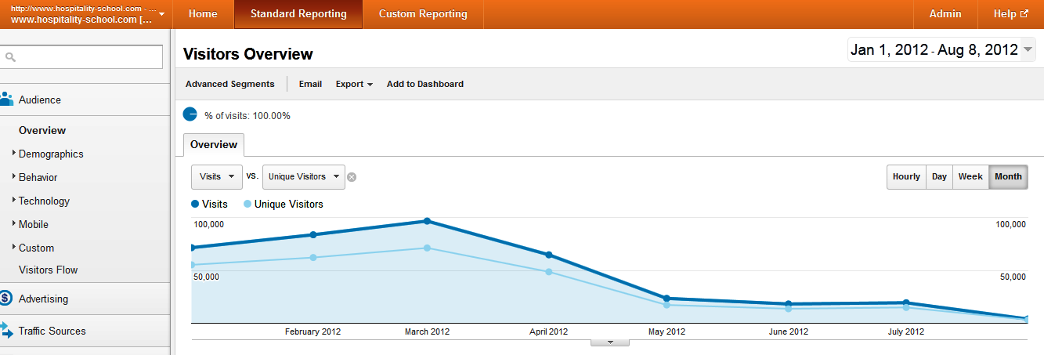
Site Popularity-2
Before penguin update site was doing well. It has never been effected by any panda update. Have a look please:

Slide 20
Conclusion
Here in this presentation we have tried our level best to show efforts we have put so far to escape from Google Penalty. http://www.hospitality-school.com has been a unique basic Free training site for hospitality students. Beside this site there has been very few sites on this field. It helps thousands of students from late 2009. Our main traffic comes from very non popular search terms related to hospitality training which has been a reason of its popularity. There are hardly any competitor there. So if you lower our ranking then many students will not get good search results.
We are Adsense Publisher from January 2010. If Google team check our account status over there they should find us very trustworthy partner.
We hope Google team will go through everything in this presentation and acknowledge our hard work and let us escape from Penguin penalty. At least we hope don’t give us sitewide penalty. Many of our pages are really very unique and helpful for users searching information on this hospitality field.
Thanks in advanced.

