Slide 1
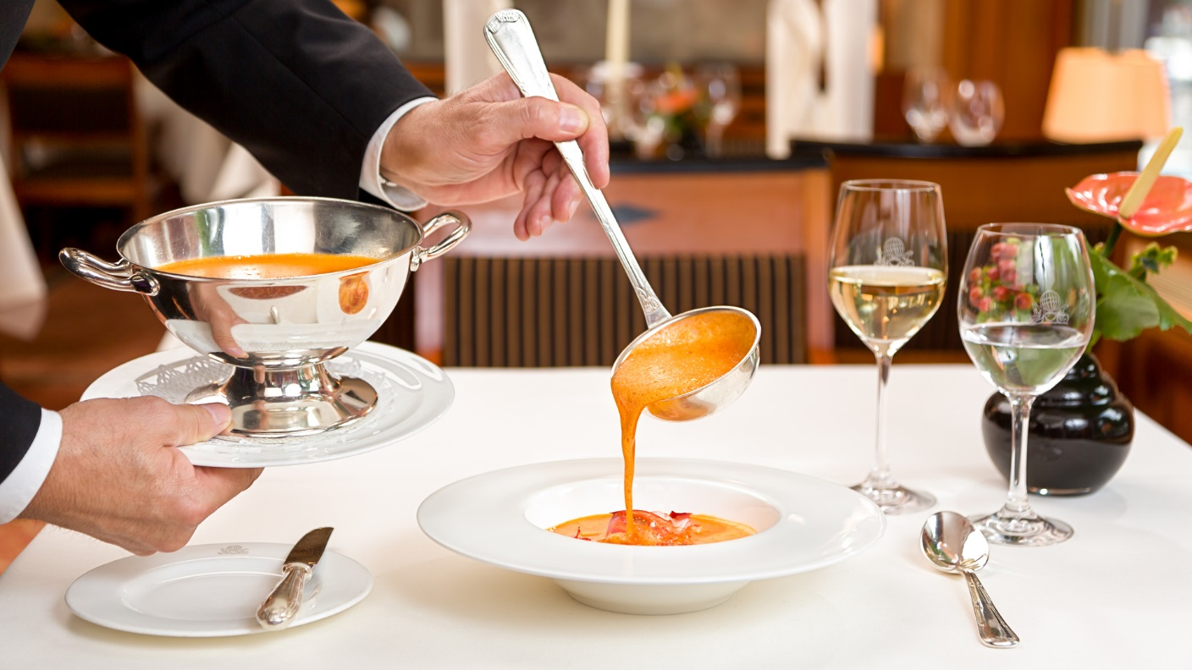
Learn How to Provide Soup Service

Slide 2
Standard
To provide the soup service with delicacy and professionalism in order to please the guests.

Slide 3
Procedures
Mise-en-place
Bone plates
Soup bowls
Spoons
Soup ladle on tray

Slide 4
Continued
Keep the soup bowls with bone plates in the middle section of the table.
Ensure that the center of the guest table is empty.
Pick up the soup tureen with your both hands carefully and place at the center of table.
Uncover the soup tureen and put the cover beside soup tureen.

Slide 5
Continued
Hold the ladle and bone plate using your right hand and left hand respectably.
Pour the soup into soup bowls until it is 90% full using the soup ladle.
Serve soup to the guests in a polite manner by saying: “Here is your----soup, please”.
Take back the soup tureen away with both hands.

Slide 6
Continued
Change the bone plate if it is soiled or dirty and replace it with a fresh one.
Collect soup bowls if guests have finished their meal.
Lastly, clear the table by taking away the soup ladle and bone plate.

